Slide 1
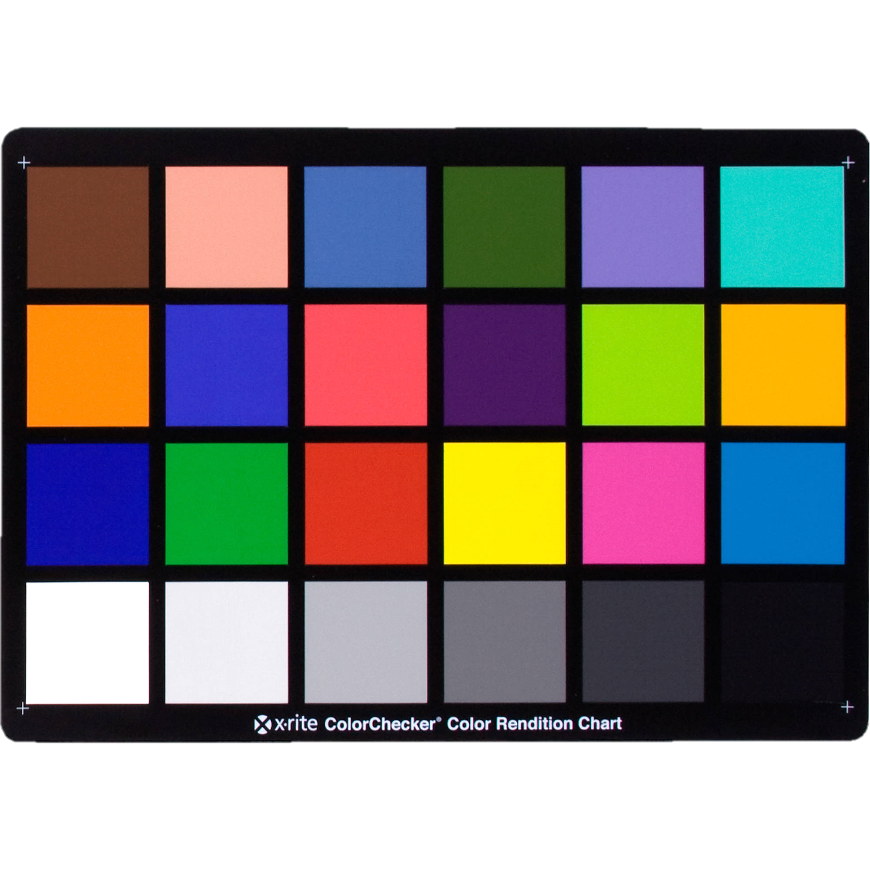

APPLIED PHYSICS 187
DR. MARICOR SORIANO
Activity 8
COLOR
DIFFERENCE
RENE L. PRINCIPE JR
2015-04622

Slide 2

Results
02
Table 1. Color Difference of Macbeth color rendition in CIE L*a*b* color space using a D65 illuminant and a fluorescent illuminant.
PATCH | CIE 76DE | DE in Chroma and Hue
1 | 3.75 | 2.12
2 | 4.01 | 1.34
3 | 4.30 | 2.69
4 | 1.81 | 0.94
5 | 2.23 | 2.23
6 | 6.40 | 2.49
7 | 8.18 | 6.15
8 | 4.11 | 3.74
9 | 8.38 | 7.38
10 | 2.58 | 1.84
11 | 2.82 | 1.57
12 | 7.15 | 3.82
13 | 4.30 | 4.13
14 | 5.50 | 3.30
15 | 12.86 | 12.22
16 | 4.77 | 3.13
17 | 8.04 | 7.18
18 | 7.70 | 5.11
19 | 2.93 | 2.94
20 | 2.56 | 2.56
21 | 2.20 | 2.20
22 | 1.83 | 1.82
23 | 1.45 | 1.44
24 | 1.02 | 3.29
In this activity, I used the illuminants D65 and Fluorescent to render the XYZ tristimulus values. I then converted these values to CIE L*a*b* colorspace using the formulas in [1]. The color difference (dE, delta E) was then measured as per CIE 76DE and DE in Chroma and Hue. The tabulated color difference of Macbeth 24 patches is shown in Table 1. DE less than 2.3 were highlighted to indicate which color patches had the minimal color difference when rendered under the fluorescent ad D65 light sources.
Reference:
[1] M. Soriano. Uniform Color Spaces, Color Difference and Color Appearance Phenomena (2019).

